Slide 1
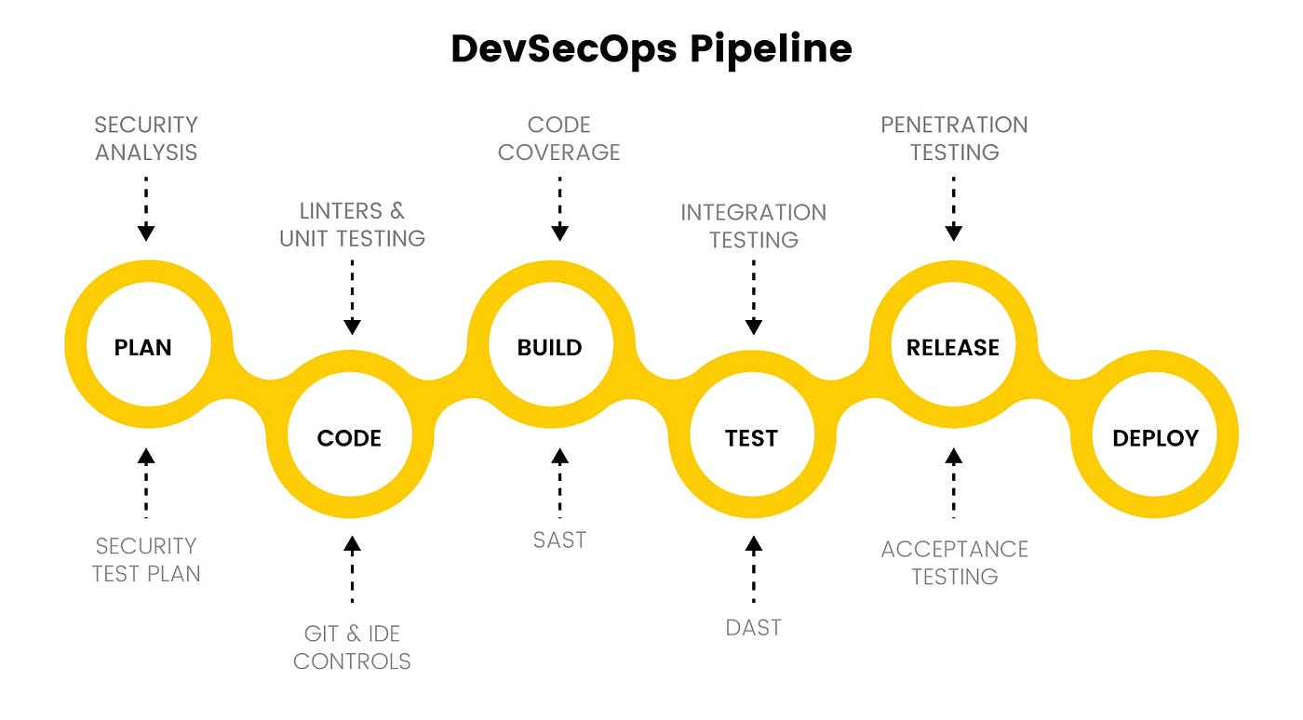
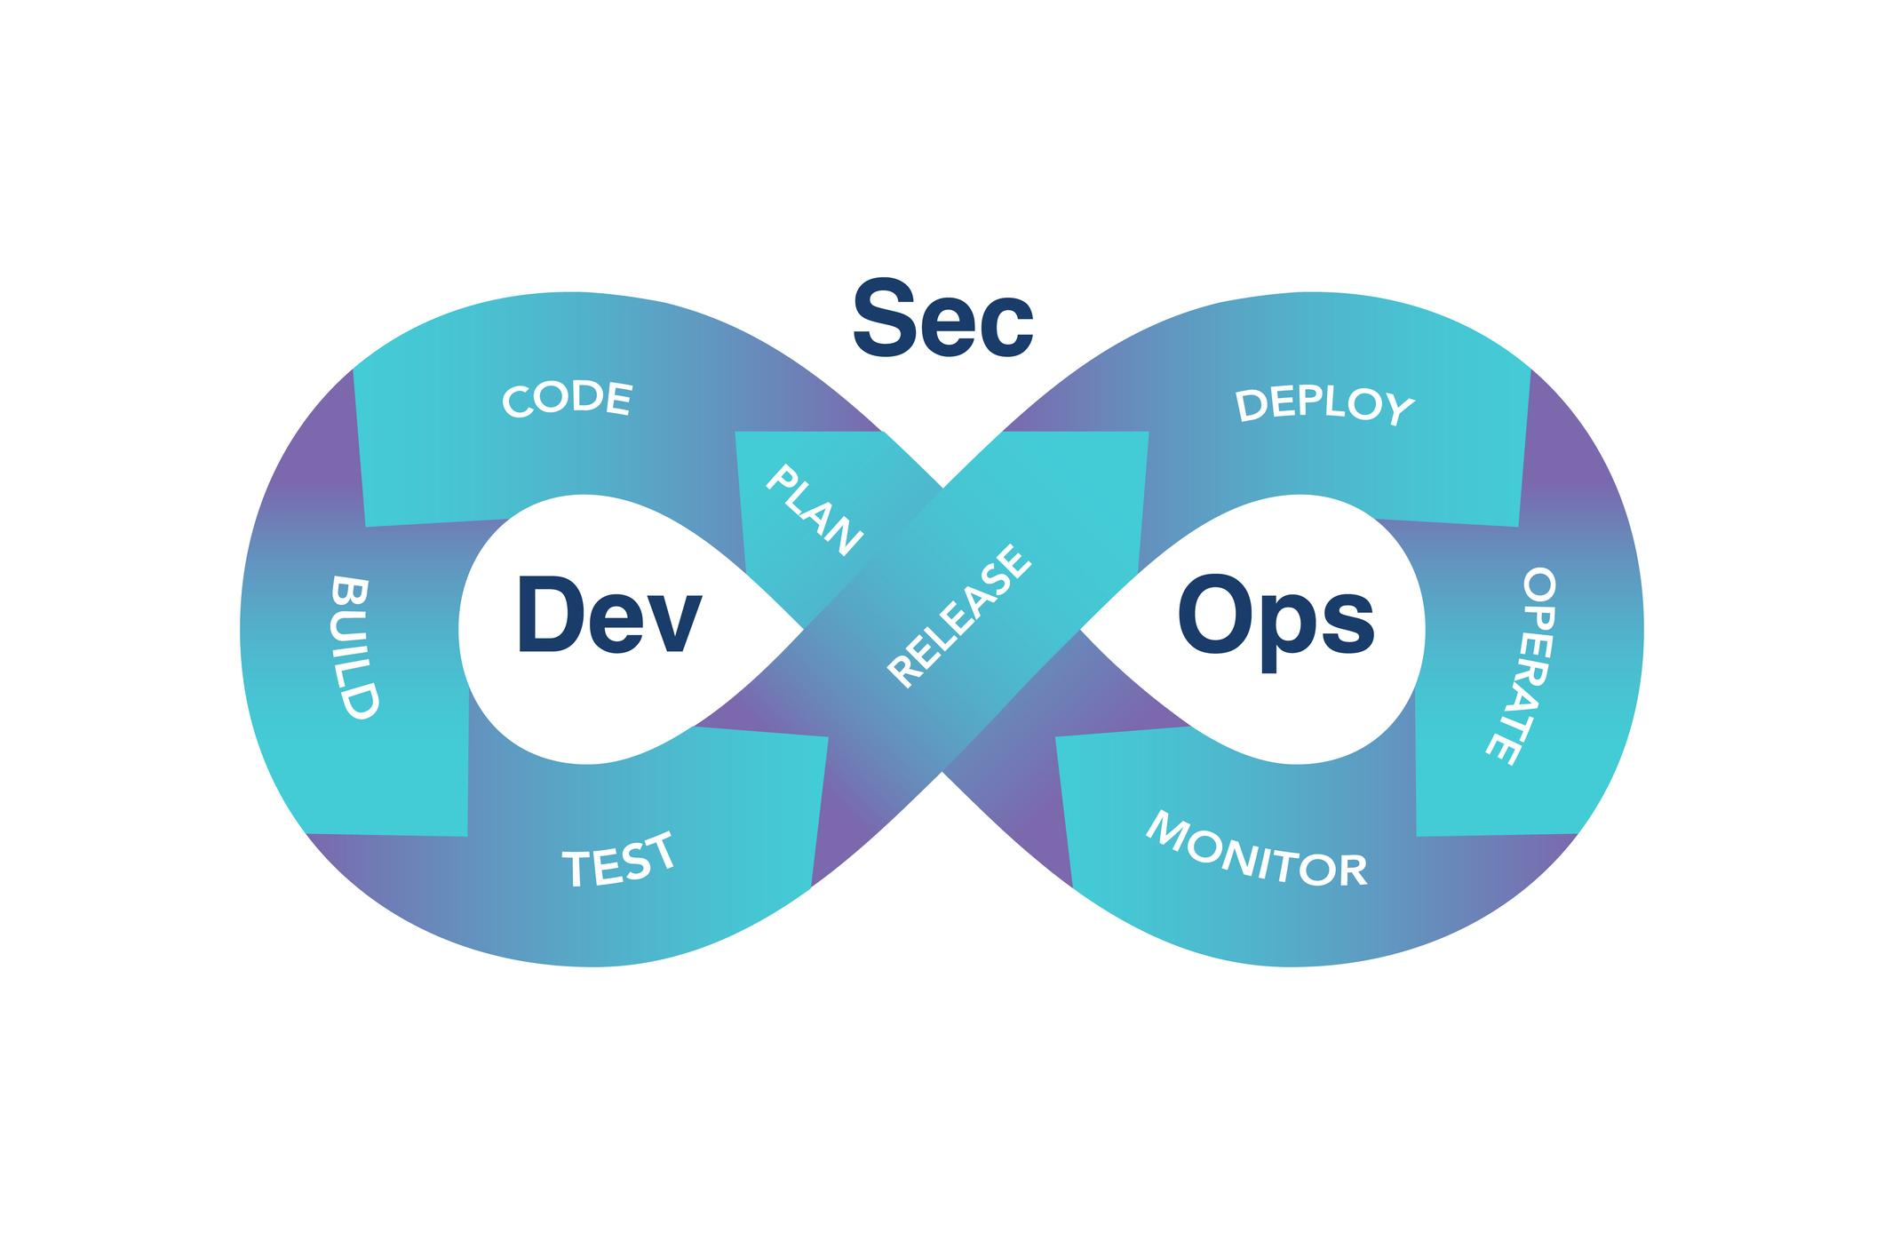
What is DevSecOps?

Slide 2
Definition
DevSecOps stands for Development + Security + Operations. It is a modern software engineering approach where security is integrated into every phase of the DevOps lifecycle, rather than being added at the end.
Instead of:
Build → Test → Deploy → Then security review
DevSecOps promotes:
Build → Secure while building → Test securely → Deploy securely → Monitor continuously

Slide 3
Evolution: From DevOps to DevSecOps
Traditional Model | DevOps | DevSecOps
Security at end | Faster releases | Security built-in
Manual security review | Automated CI/CD | Automated security in CI/CD
Siloed teams | Dev + Ops collaboration | Dev + Sec + Ops collaboration

Slide 4
DevSecOps Lifecycle (End-to-End)
1️⃣ Plan
Threat modeling
Security requirements
Compliance mapping (ISO, SOC2, PCI, etc.)
2️⃣ Develop
Secure coding practices
Code reviews
SAST (Static Application Security Testing)

Slide 5
3️⃣ Build
Dependency scanning
SBOM generation
Container image scanning
4️⃣ Test
DAST (Dynamic testing)
API security testing
IAST (Interactive testing)
5️⃣ Release
Image signing
Policy enforcement
Secure artifact storage

Slide 6
6️⃣ Deploy
Infrastructure as Code (IaC) scanning
Kubernetes security controls
Secrets management
7️⃣ Operate & Monitor
Runtime security monitoring
Log analysis
Incident response
Continuous compliance

Slide 7
Key DevSecOps Components
1. Automated Security Testing
SAST – Scan source code
DAST – Scan running apps
SCA – Scan open-source dependencies
IaC Scanning – Detect misconfigurations
Container Scanning – Detect vulnerabilities

Slide 8
2. Secrets Management
Avoid hardcoding secrets
Use vault systems
Rotate credentials automatically

Slide 9
3. Policy as Code
Security policies written in code
Automatically enforced in pipelines
Example: Prevent public S3 buckets

Slide 10
4. Container & Kubernetes Security
Minimal base images
Non-root containers
RBAC controls
Network policies

Slide 11
5. Supply Chain Security
SBOM generation
Dependency validation
Artifact signing
Zero Trust pipelines

Slide 12
Core Principles of DevSecOps
Shift Left Security
Automation First
Continuous Monitoring
Least Privilege Access
Zero Trust Architecture
Compliance as Code
Shared Responsibility Culture

Slide 13
Why DevSecOps is Important
Faster secure releases
✅ Reduced vulnerability cost (fix early = cheaper)
✅ Better compliance readiness
✅ Lower breach risk
✅ Stronger software supply chain
A vulnerability fixed during development costs 10x–100x less than fixing it in production.

Slide 14
DevOps vs DevSecOps
Feature | DevOps | DevSecOps
Focus | Speed & automation | Speed + security
Security | Separate team | Embedded in pipeline
Testing | Functional | Functional + security
Monitoring | Performance | Performance + threat detection

Slide 15
Real-World Example
Imagine building a cloud-native application:
Without DevSecOps:
Developers code
Security team scans before production
Major vulnerabilities found
Release delayed
With DevSecOps:
Code automatically scanned during commit
Container scanned at build
IaC scanned before deployment
Policies enforced automatically
Deployment happens securely & faster

Slide 16
Cultural Impact
DevSecOps is not just tools — it's a mindset:
“Everyone is responsible for security.”
Developers write secure code. Operations ensure hardened infrastructure. Security teams build automated guardrails.

Slide 17
In One Sentence
DevSecOps is the practice of integrating security as a shared responsibility, automated and embedded throughout the entire software development lifecycle.

Slide 18
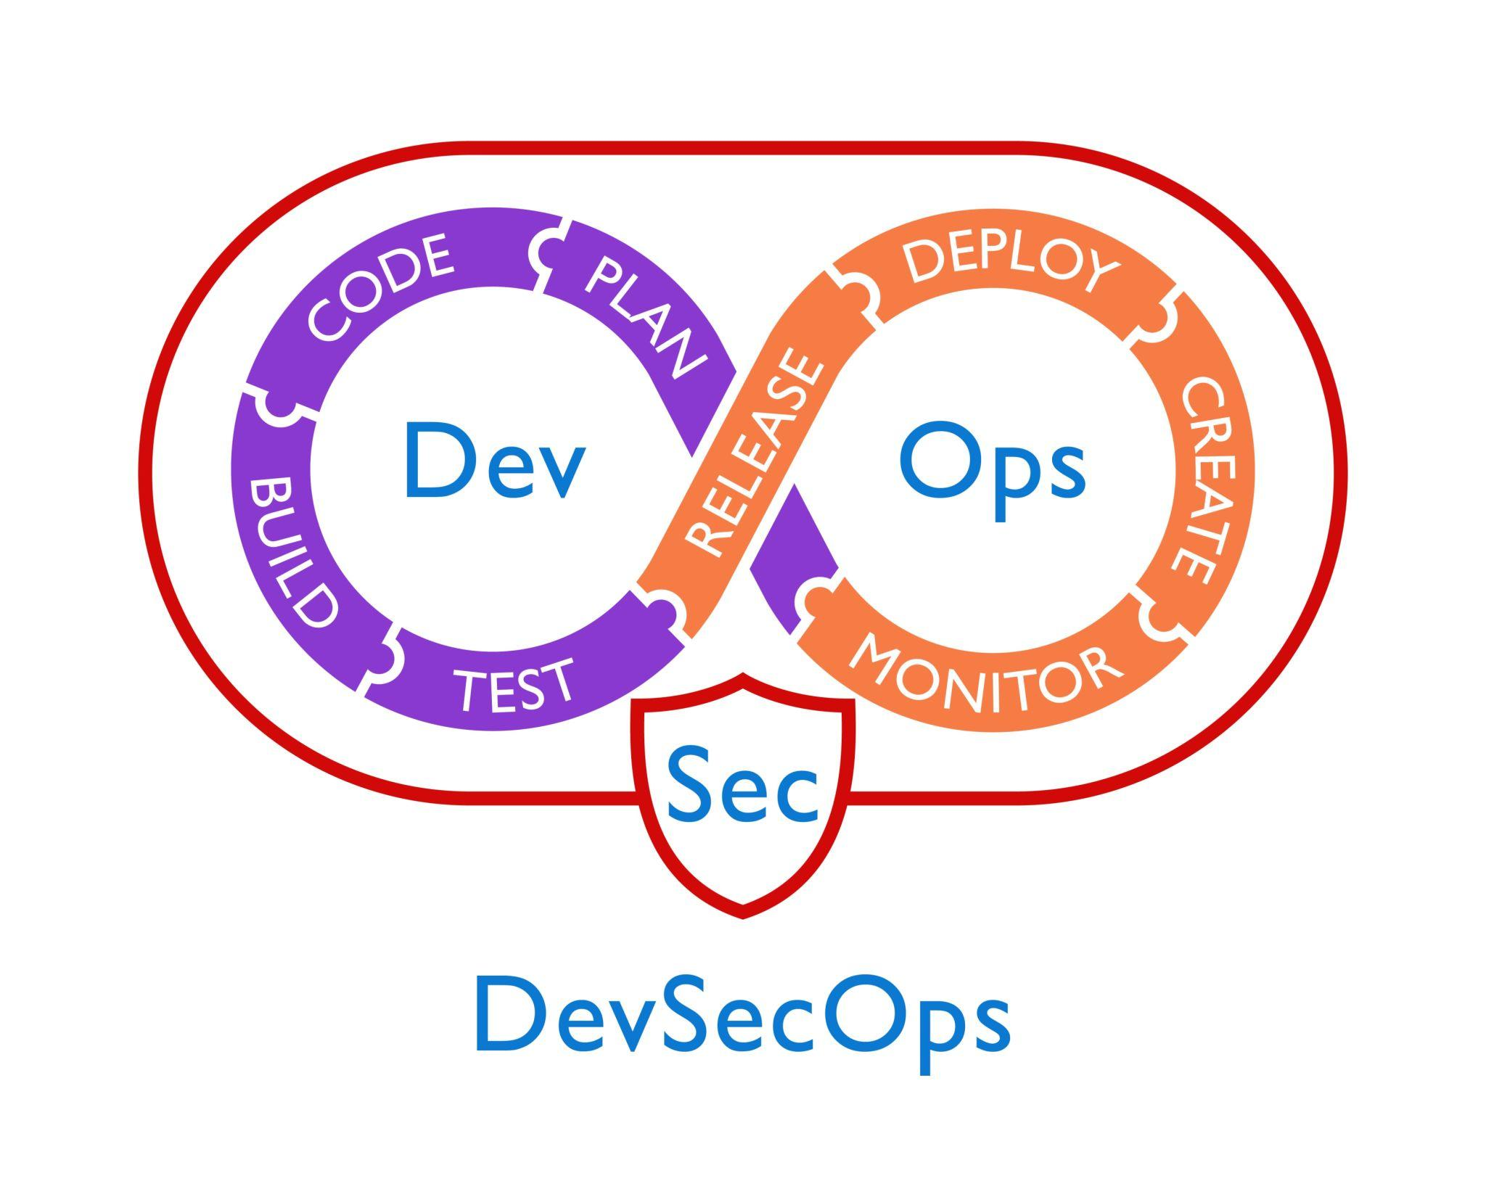
DevSecOps Architecture A DevSecOps architecture shows how security controls are embedded across the entire software delivery pipeline — from planning to runtime monitoring. Let’s break it down layer by layer.

Slide 19
High-Level Architecture Layers
A typical DevSecOps architecture has 6 main layers:
Source Control Layer
CI (Build & Test) Layer
Artifact & Registry Layer
CD / Deployment Layer
Infrastructure Layer
Monitoring & Runtime Security Layer
Each layer contains automated security controls.

Slide 20
2️⃣ Component-by-Component Explanation
1. Source Code Management (SCM)
Examples:
GitHub
GitLab
Bitbucket
Security Controls Here:
Branch protection rules
Signed commits
Secret scanning
Code review enforcement
Pre-commit hooks
🔐 Security starts at the first commit.

Slide 21
2. Continuous Integration (CI) Pipeline
Examples:
GitHub Actions
Jenkins
GitLab CI
Security Type | Purpose
SAST | Scan source code
SCA | Scan dependencies
Secret scanning | Detect exposed credentials
License scanning | Open-source compliance
SBOM generation | Dependency inventory

Slide 22
3. Artifact Repository / Container Registry
Examples:
Docker Hub
JFrog Artifactory
Amazon ECR
Security Controls:
Image vulnerability scanning
Artifact signing
Provenance tracking
Immutable artifacts
This protects the software supply chain.

Slide 23
4. Continuous Deployment (CD)
Examples:
Argo CD
Flux CD
Spinnaker
Security at Deployment:
Policy-as-Code enforcement
Infrastructure scanning
Image signature verification
Admission controllers
Secrets injection from vault
Only secure and approved artifacts reach production.

Slide 24
5. Infrastructure Layer (Cloud / Kubernetes)
Examples:
Kubernetes
Amazon Web Services
Microsoft Azure
Security Controls:
RBAC (Role-Based Access Control)
Network policies
Pod security standards
Runtime isolation
Infrastructure as Code scanning
Infrastructure must be secure by design, not manually configured.

Slide 25
6. Runtime Monitoring & Detection
Examples:
Falco
Prometheus
Grafana
Runtime Controls:
Threat detection
Log aggregation
Behavioral anomaly detection
Incident response automation
Continuous compliance checks
Security does not stop at deployment.

Slide 26
End-to-End Flow
Developer Commit
↓
SCM Security Controls
↓
CI Pipeline (SAST + SCA + SBOM)
↓
Build Secure Artifact
↓
Image Scan + Sign
↓
Push to Secure Registry
↓
CD with Policy Enforcement
↓
Secure Deployment (K8s / Cloud)
↓
Runtime Monitoring & Alerting

Slide 27
Key Architectural Principles
1️⃣ Shift Left Security
Security begins at coding stage.
2️⃣ Automation Everywhere
No manual approval bottlenecks.
3️⃣ Policy as Code
Security rules are version-controlled.
4️⃣ Immutable Infrastructure
No patching production servers manually.
5️⃣ Zero Trust
Every component verifies identity and integrity.

Slide 28
A complete DevSecOps architecture integrates:
Layer | Security Focus
Code | Secure coding
Build | Automated scanning
Artifact | Supply chain security
Deploy | Policy enforcement
Infra | Hardened configuration
Runtime | Continuous detection

Slide 29
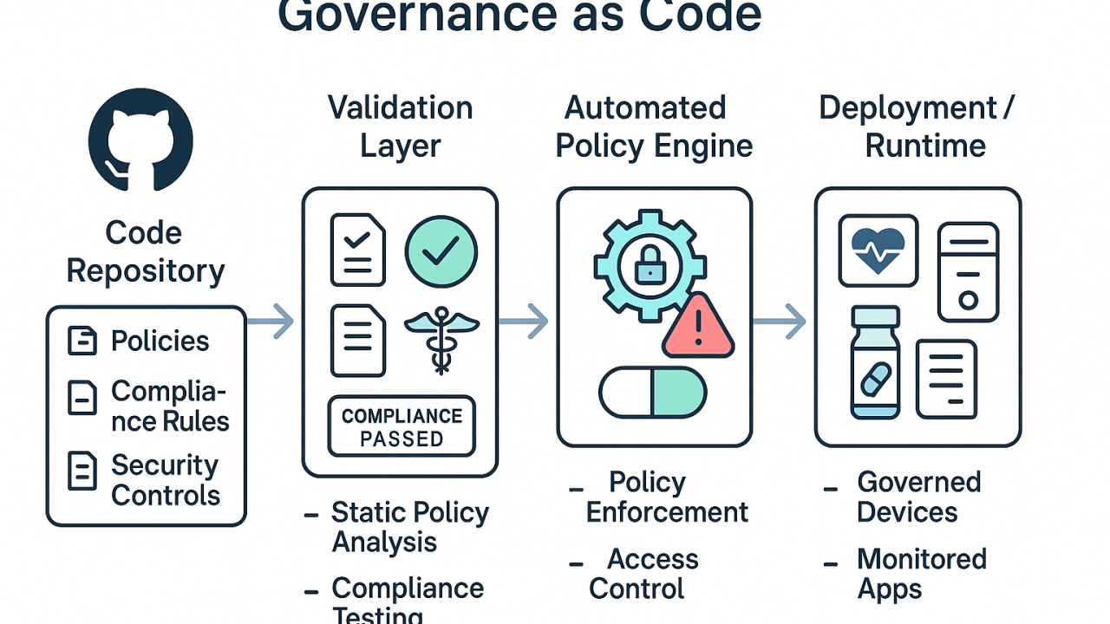
DevSecOps Governance Framework Template (Enterprise-Ready)

Slide 30
This template is designed for large enterprises implementing structured DevSecOps with compliance, auditability, and measurable risk control.
You can directly adapt this into:
Governance policy document
Board-level security model
Audit framework
DevSecOps CoE charter

Slide 31
1️⃣ Governance Structure Overview
🎯 Governance Objectives
Embed security across SDLC
Reduce enterprise risk exposure
Ensure regulatory compliance
Enable secure innovation at scale
Provide measurable risk visibility

Slide 32
2️⃣ Governance Operating Model
Layer | Responsibility | Owner
Strategic | Define security vision & risk appetite | CISO / CTO
Tactical | Define policies & standards | Security Architecture
Operational | Enforce policies via automation | Platform Engineering
Assurance | Audit & compliance validation | Internal Audit

Slide 33
B. Three Lines of Defense Model
1️⃣ Engineering Teams (First Line) 2️⃣ Security & Risk (Second Line) 3️⃣ Audit & Compliance (Third Line)
Security enforcement happens through automation — not manual approval.

Slide 34
3️ DevSecOps Policy Framework
Secure SDLC Policy
Defines:
Secure coding standards
Code review requirements
Threat modeling mandate
Security testing requirements
Vulnerability remediation SLAs

Slide 35
2. CI/CD Security Policy
Mandatory controls:
SAST in every build
Dependency scanning (SCA)
Secret detection
SBOM generation
Artifact signing
Policy gate enforcement
Example Policy Rule:
Block build if Critical vulnerability CVSS ≥ 9.0

Slide 36
3. Cloud & Infrastructure Policy
Applies to:
Kubernetes
Amazon Web Services
Microsoft Azure
Controls:
RBAC enforcement
Encryption at rest & transit
Network segmentation
CIS benchmark compliance
Infrastructure as Code scanning

Slide 37
4. Supply Chain Security Policy
Includes:
SBOM maintenance
Approved base images only
Image signing & verification
Dependency provenance validation
Open-source license compliance

Slide 38
5. Runtime & Monitoring Policy
ncludes:
Log retention standards
Incident response timelines
Threat detection coverage
Continuous compliance scanning
Zero Trust enforcement

Slide 39
Policy as Code Governance Model
Governance is implemented via automation using:
OPA (Open Policy Agent)
Admission controllers
CI pipeline gates
Cloud policy engines
Git-based policy repositories
Benefits: ✔ No manual approval delays ✔ Consistent enforcement ✔ Audit traceability

Slide 40
Vulnerability Management Governance
Severity | SLA | Escalation
Critical | 24–48 hours | VP Engineering
High | 7 days | Engineering Manager
Medium | 30 days | Product Owner
Low | Risk accepted or backlog
Governance ensures:
No production deployment with unapproved critical CVEs
Exception process documented
Risk acceptance tracked

Slide 41
Compliance & Regulatory Alignment
Map DevSecOps controls to:
ISO 27001
SOC 2
PCI-DSS
NIST CSF
CIS Benchmarks
Governance requires:
✔ Automated evidence collection ✔ Compliance dashboard ✔ Audit-ready reporting

Slide 42
Enterprise DevSecOps RACI Matrix
Activity | Dev | Sec | Ops | Platform | Audit
Secure Coding | R | C | - | - | -
Security Testing | R | A | - | C | -
Policy Definition | - | A | - | C | C
CI Pipeline Security | C | C | - | A | -
Runtime Monitoring | - | C | R | C | -
Audit Reporting | - | C | - | C | A

Slide 43
Metrics & Reporting Framework
Enterprise dashboards should track:
% of builds passing security checks
Mean Time to Remediate (MTTR)
Vulnerability age distribution
Policy violation frequency
Compliance coverage %
Deployment frequency vs risk score
Executive reporting should focus on:
Risk exposure trend over time.

Slide 44
DevSecOps Maturity Governance Levels
Level | Governance Capability
Level 1 | Manual security review
Level 2 | Automated scanning
Level 3 | Policy as Code
Level 4 | Continuous compliance
Level 5 | Predictive risk analytics

Slide 45
Governance Documentation Template Structure
You can structure your governance document as:
Executive Summary
Scope & Applicability
Governance Structure
DevSecOps Policies
Security Controls Matrix
Risk & SLA Framework
Compliance Mapping
Reporting & Metrics
Exception Management
Continuous Improvement Process

Slide 46
A DevSecOps Governance Framework ensures:
Security is measurable, enforceable, automated, and auditable — without slowing innovation.

